Slide 1
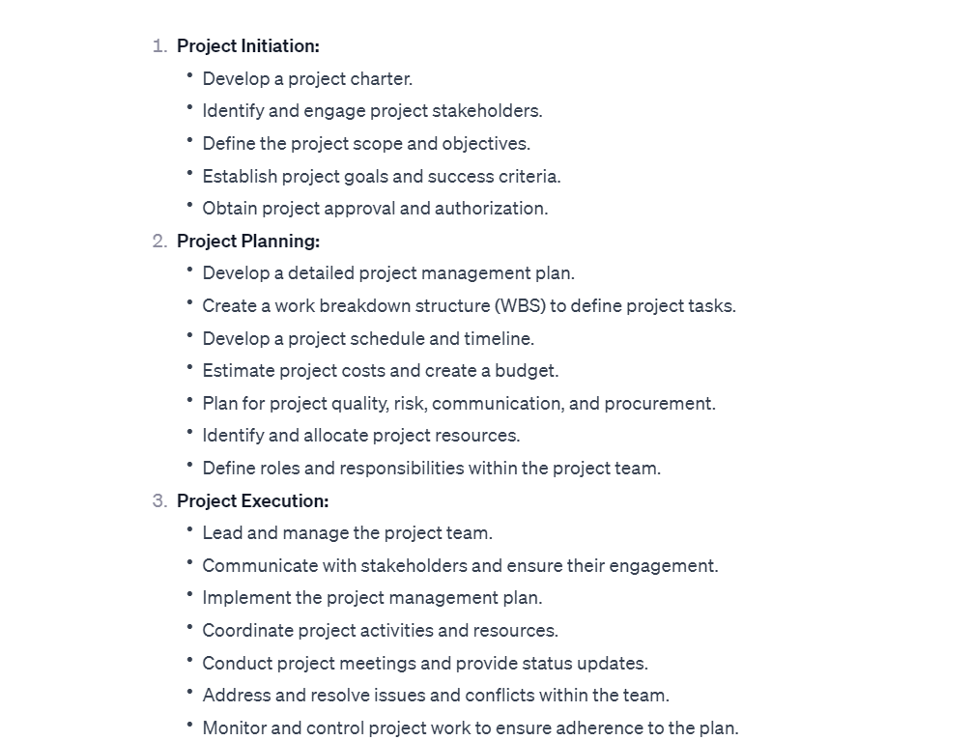

Slide 2
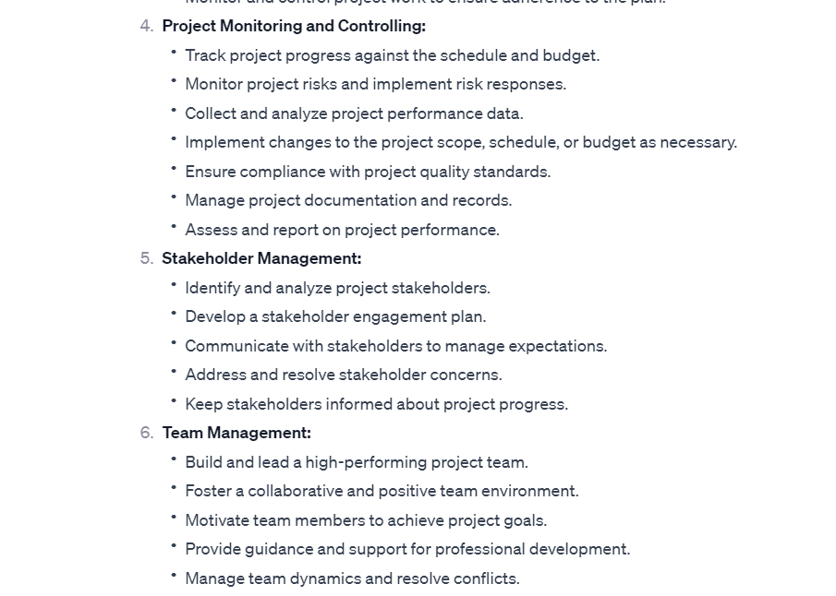

Slide 3
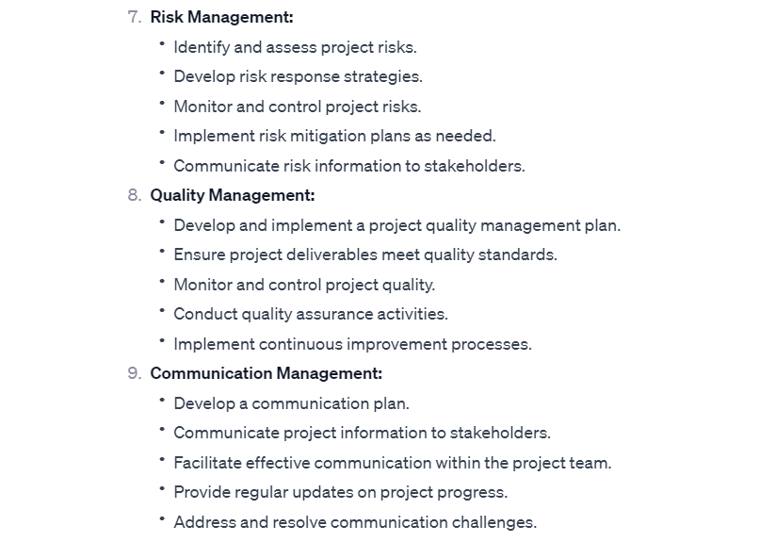

Slide 4
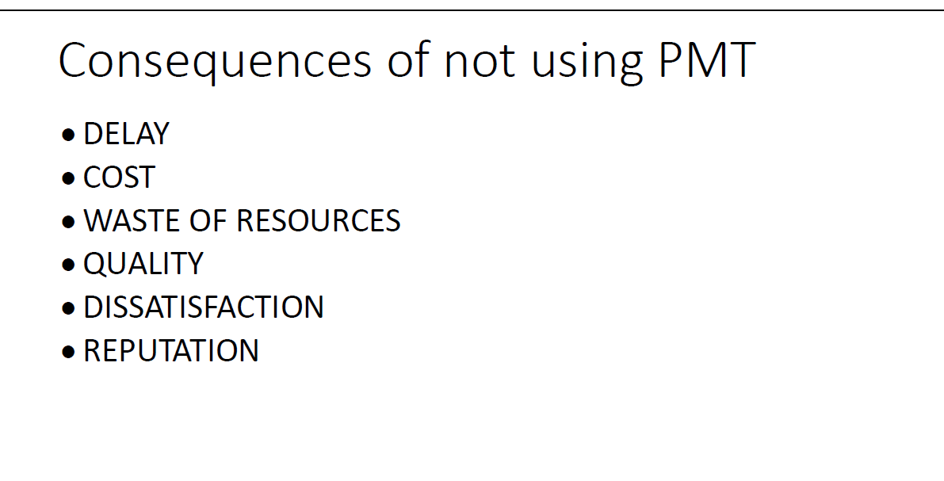
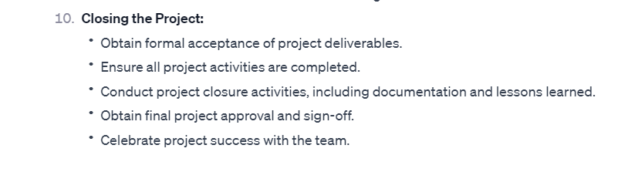

Slide 5
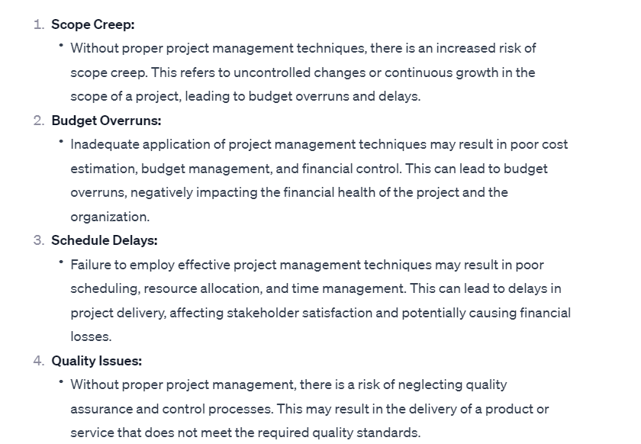

Slide 6
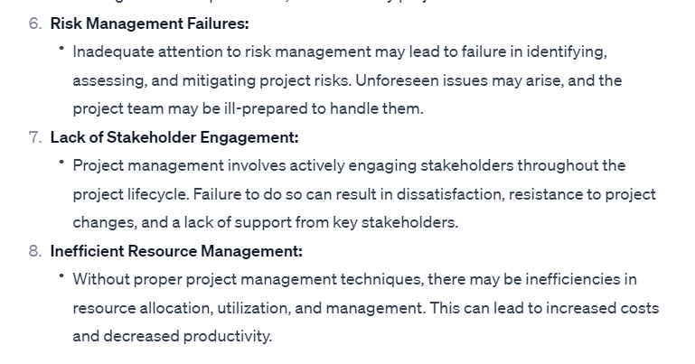

Slide 7
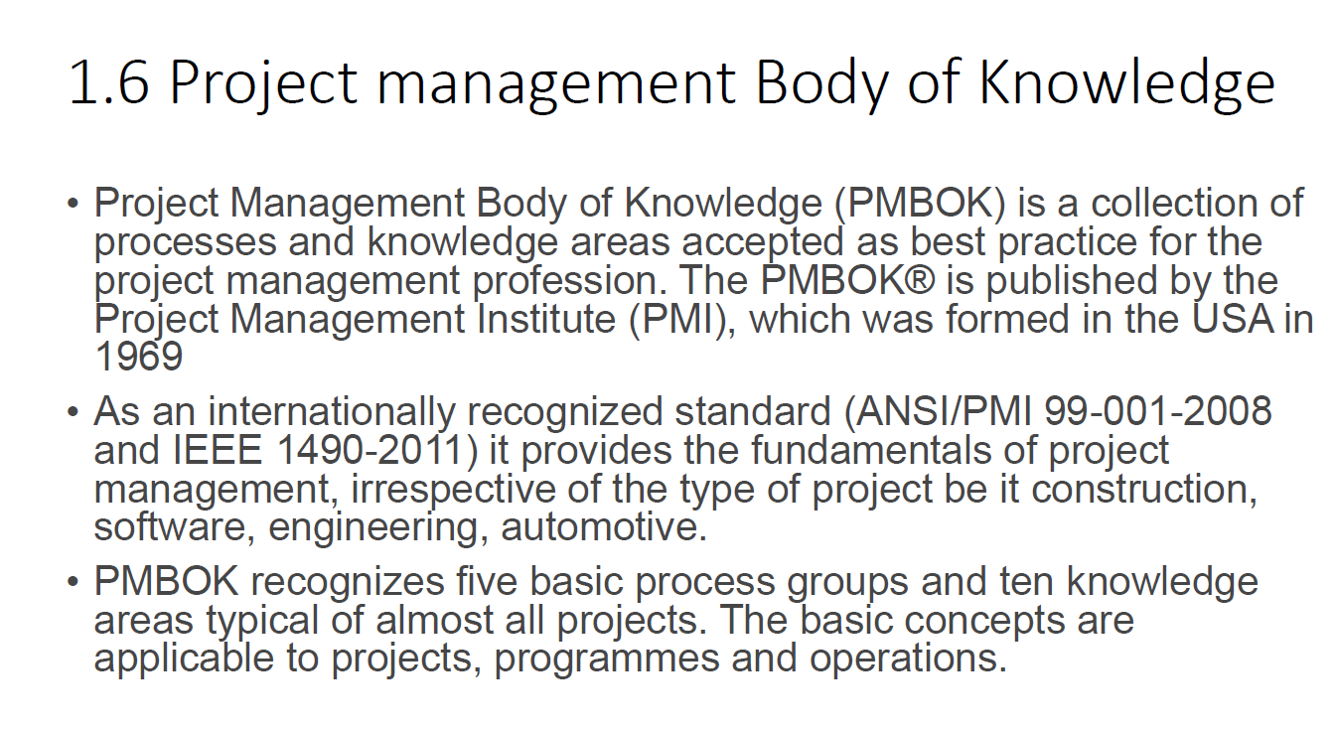

Slide 8
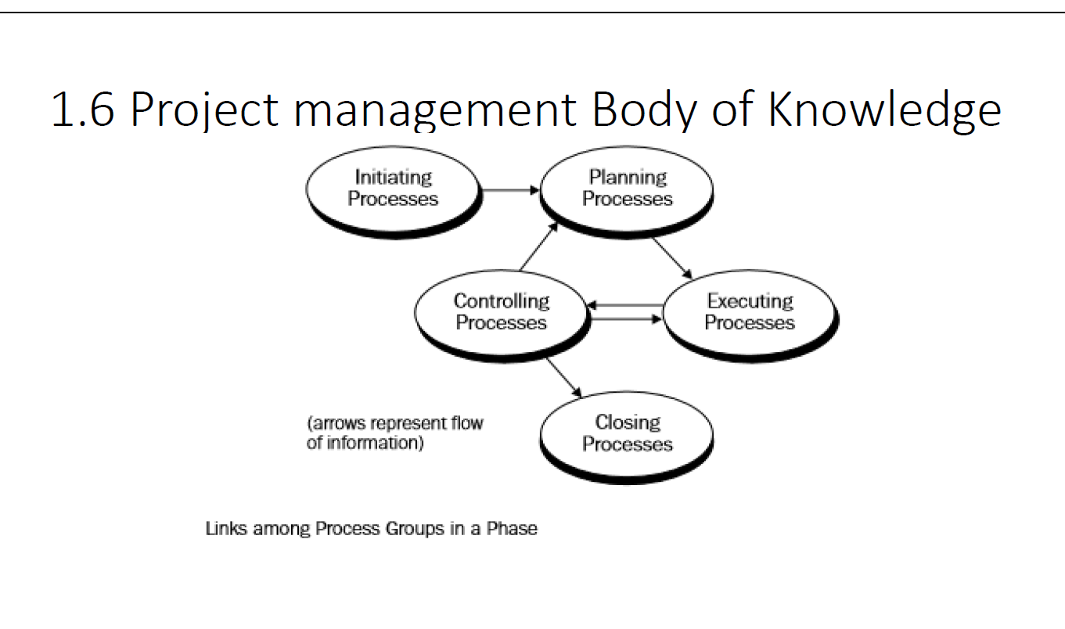

Slide 9
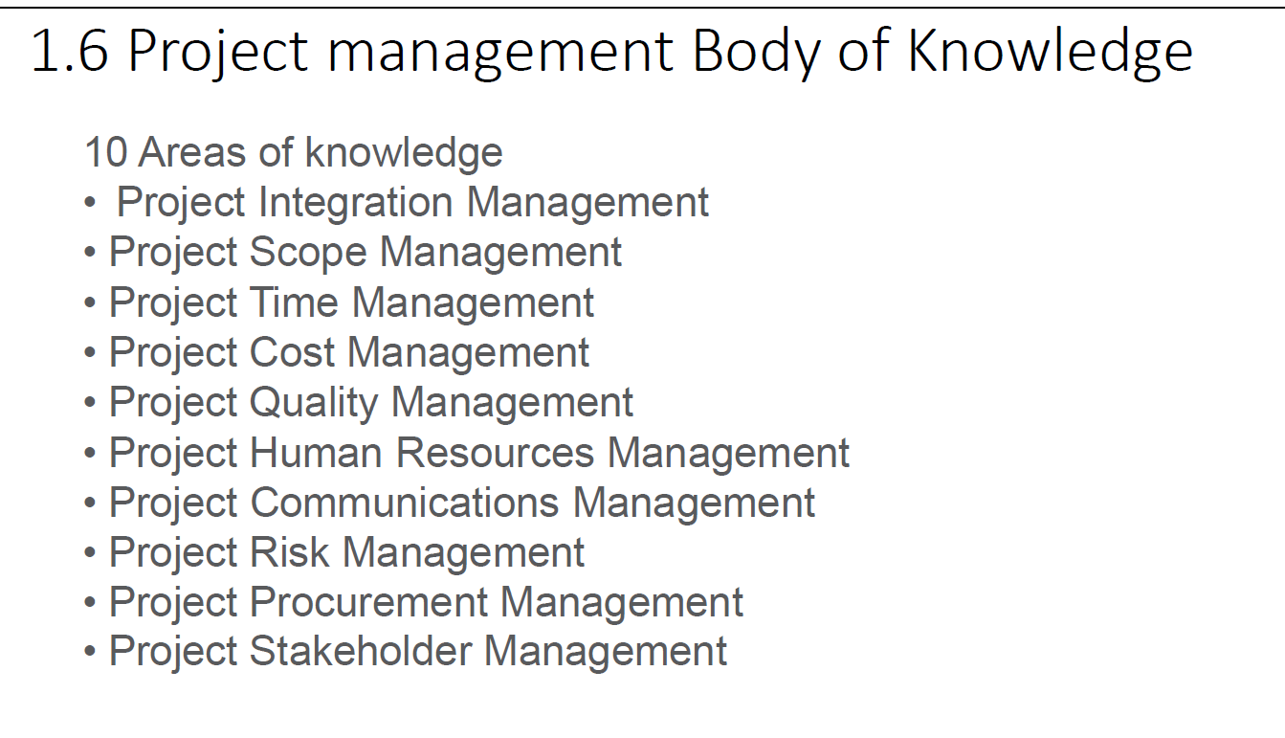

Slide 10
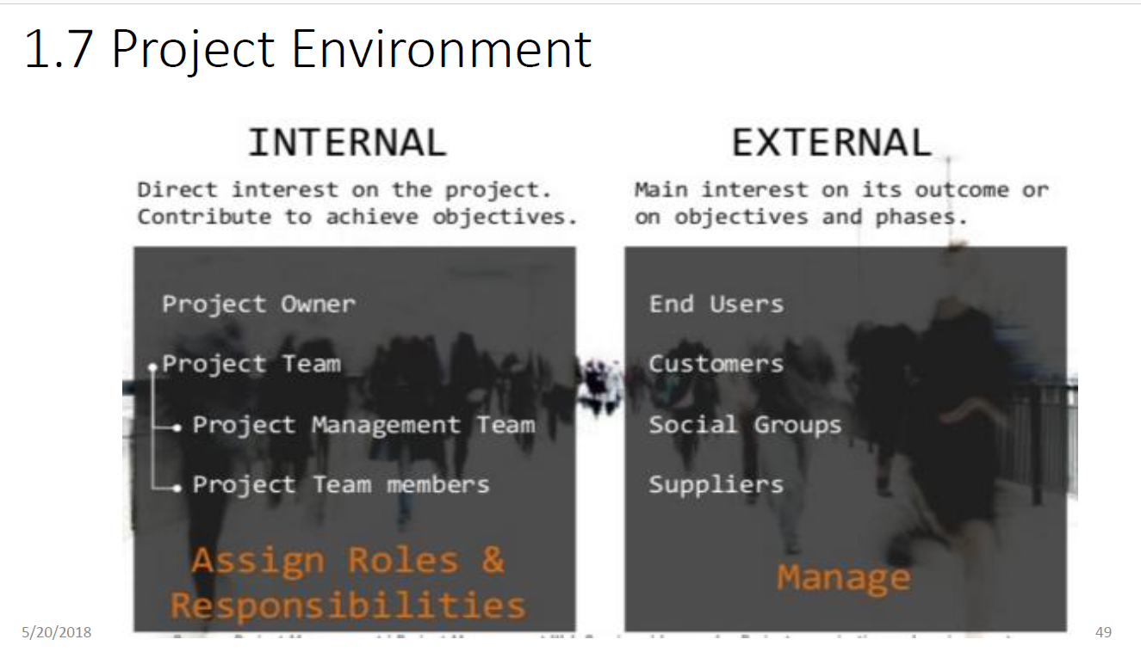

Slide 11
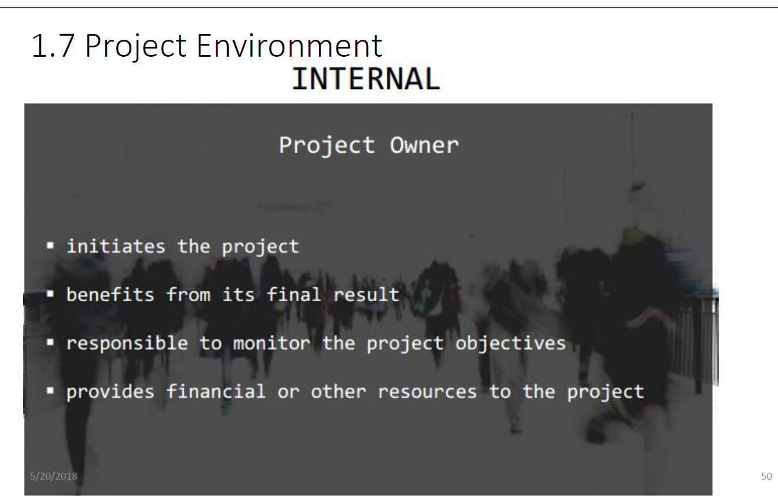

Slide 12
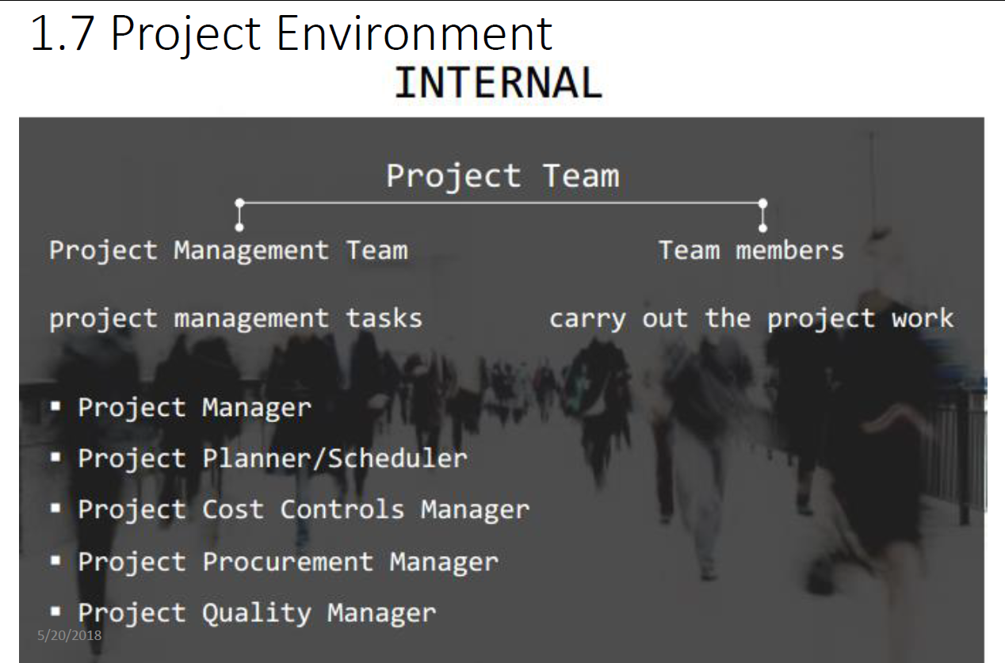

Slide 13
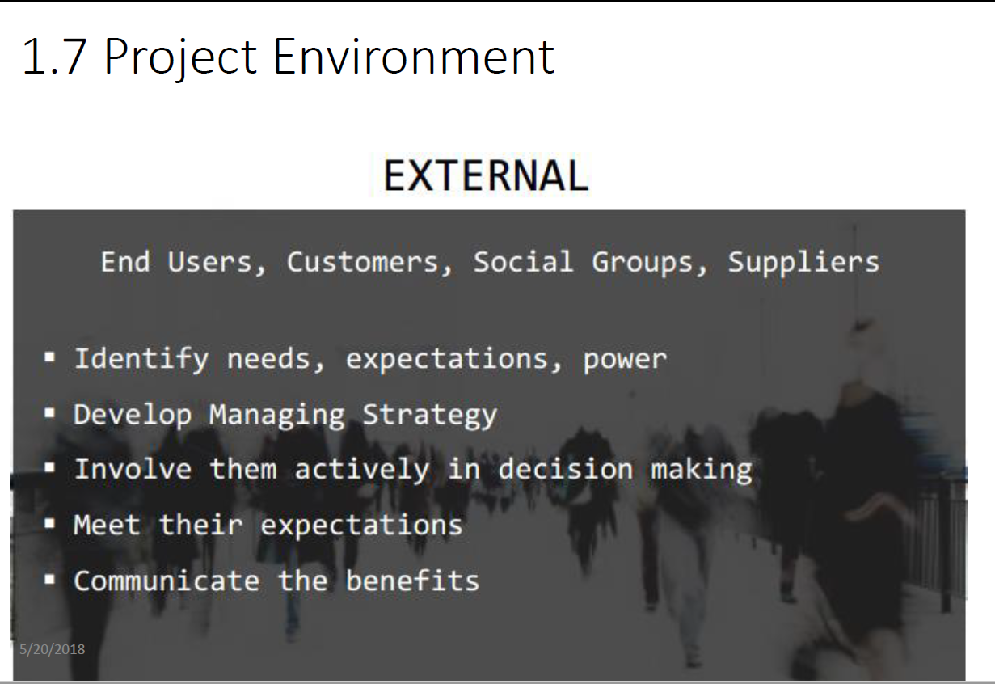

Slide 14
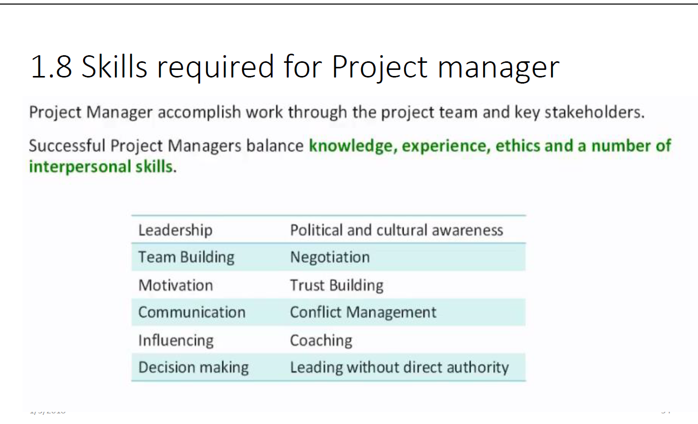

Slide 15
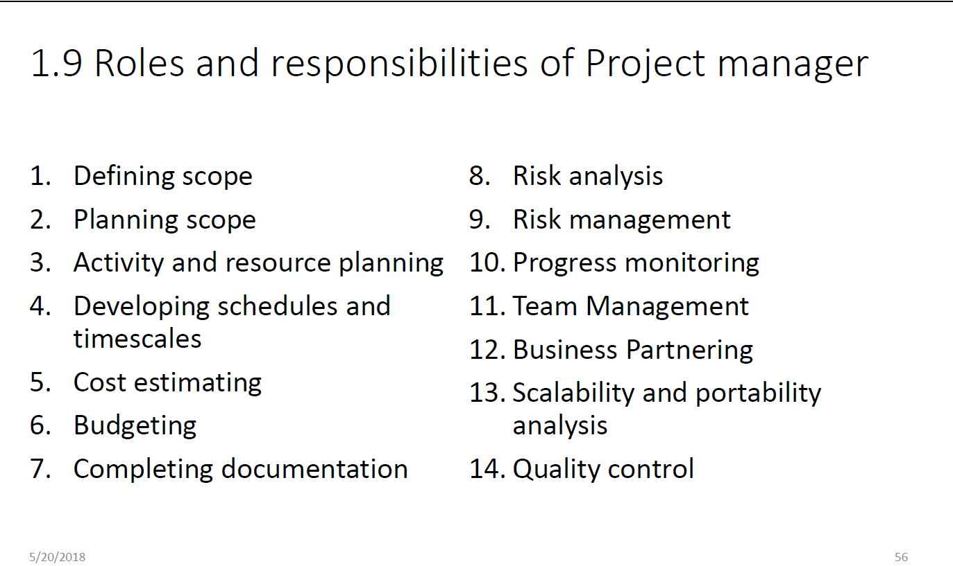

Slide 16


Slide 17
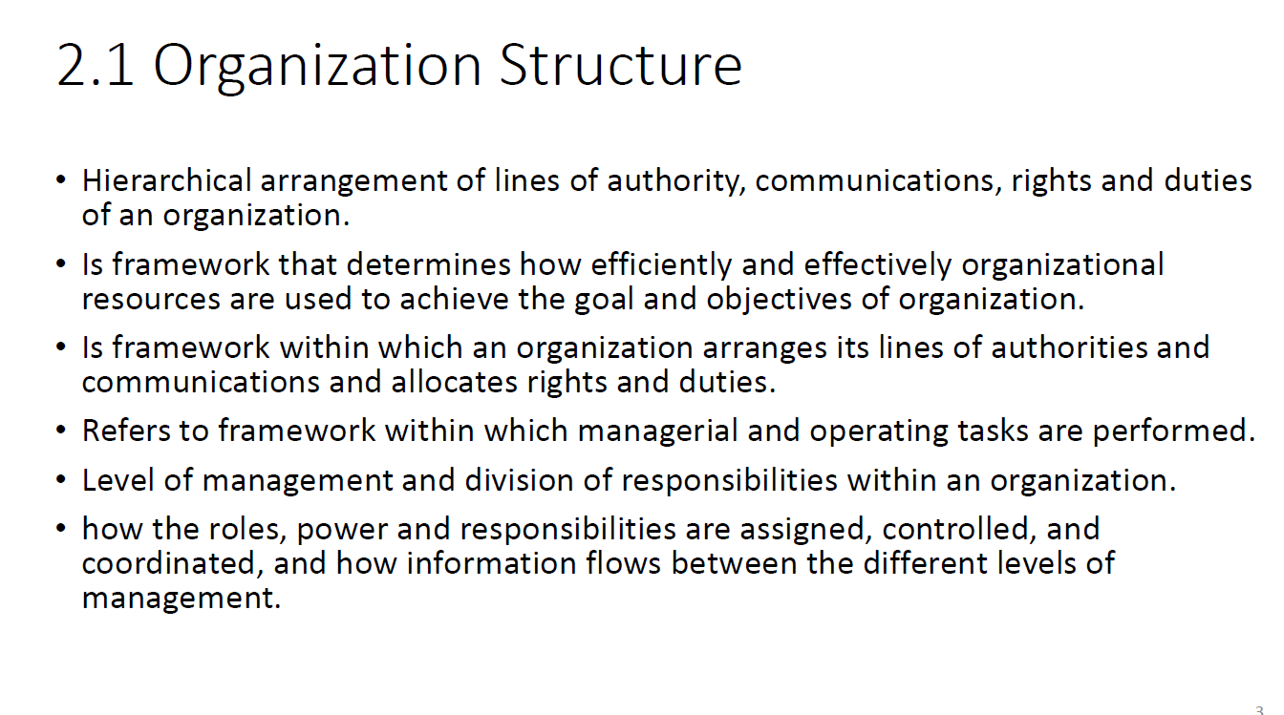

Slide 18
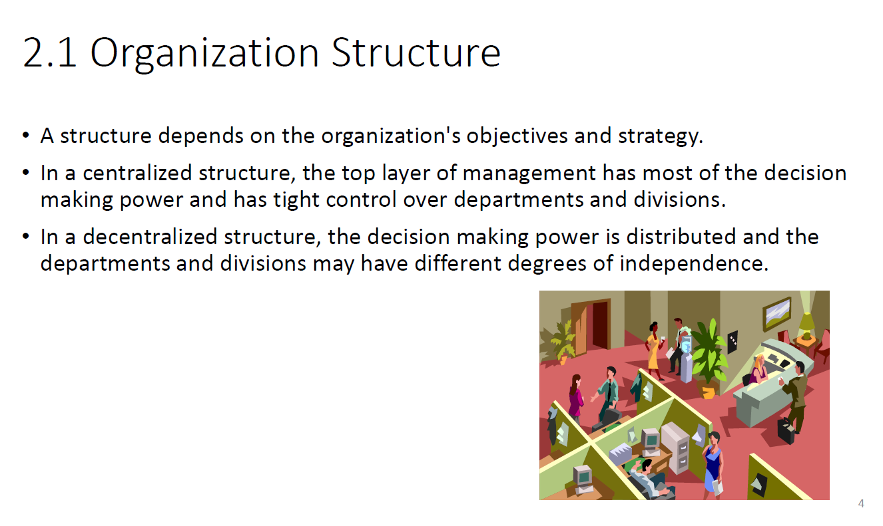

Slide 19
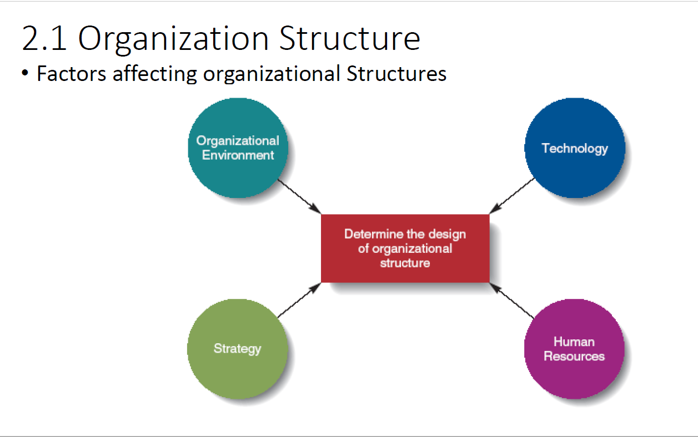

Slide 20
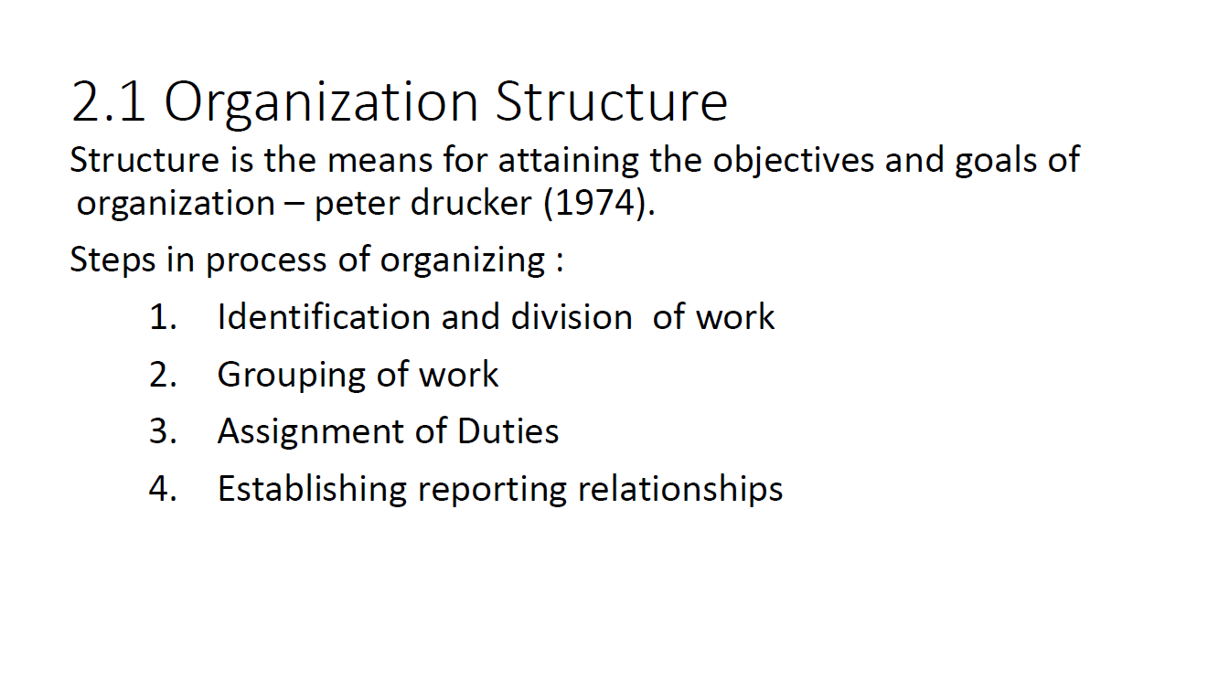

Slide 21
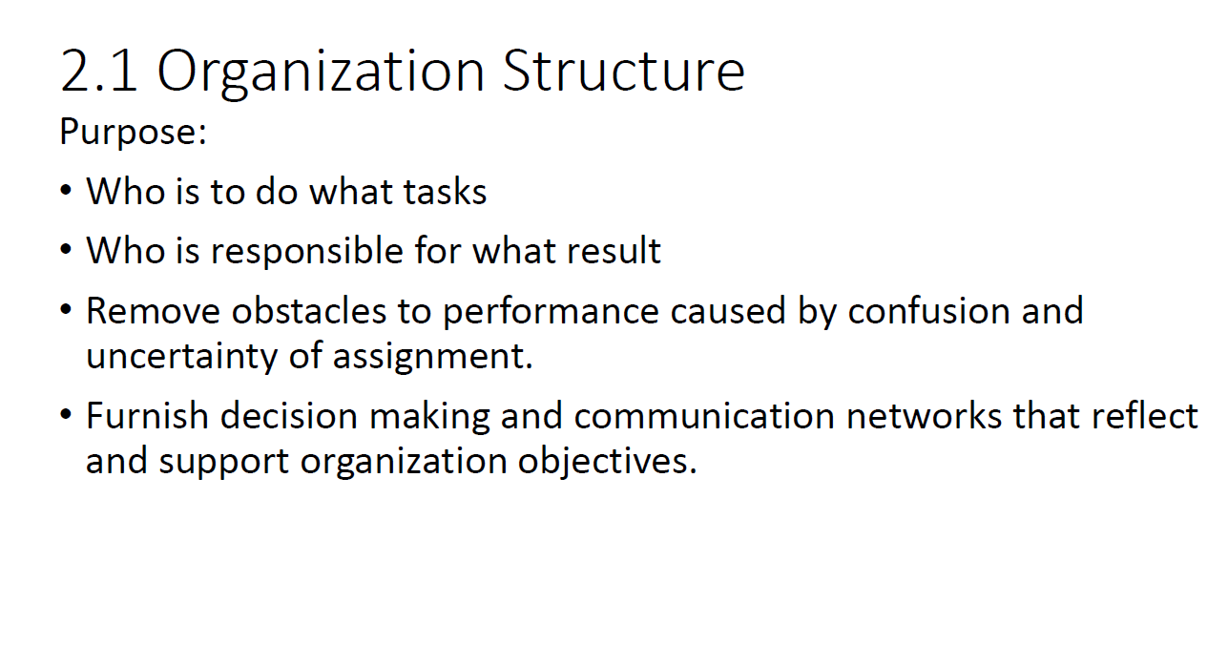

Slide 22
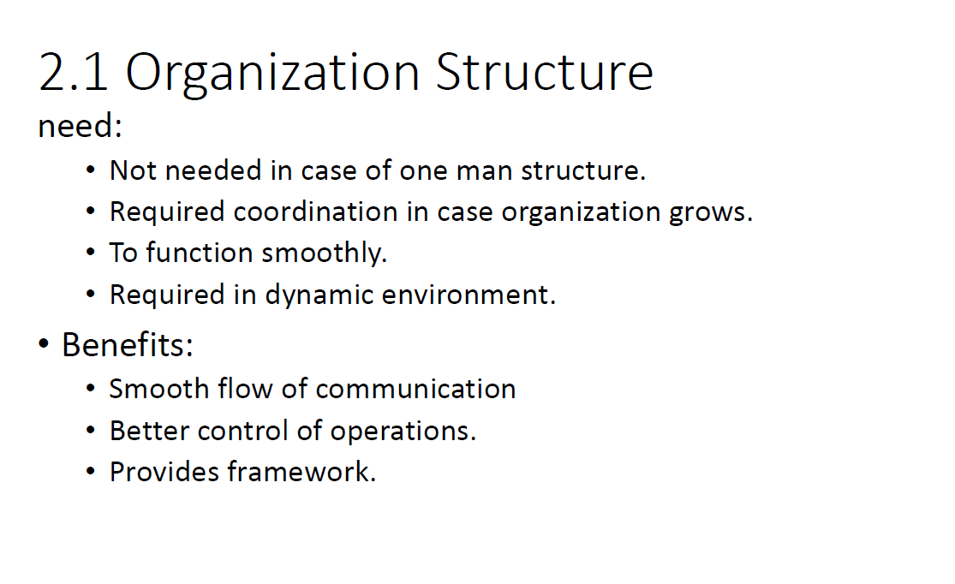

Slide 23
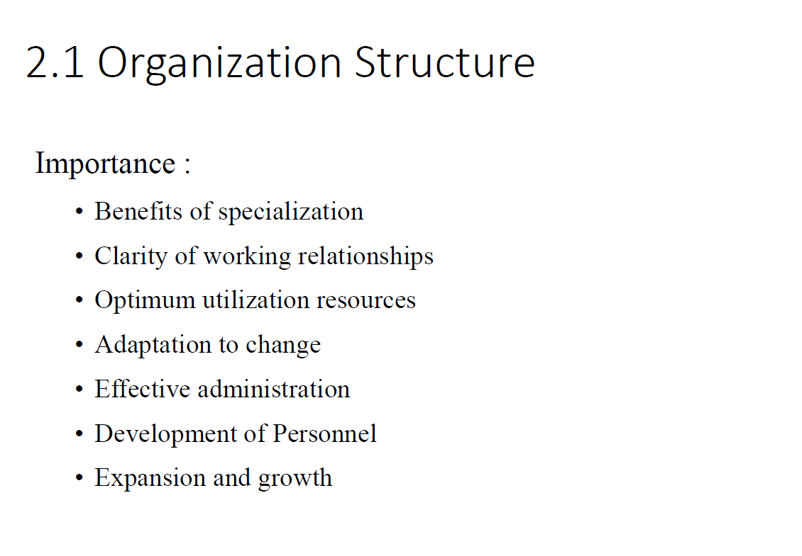

Slide 24
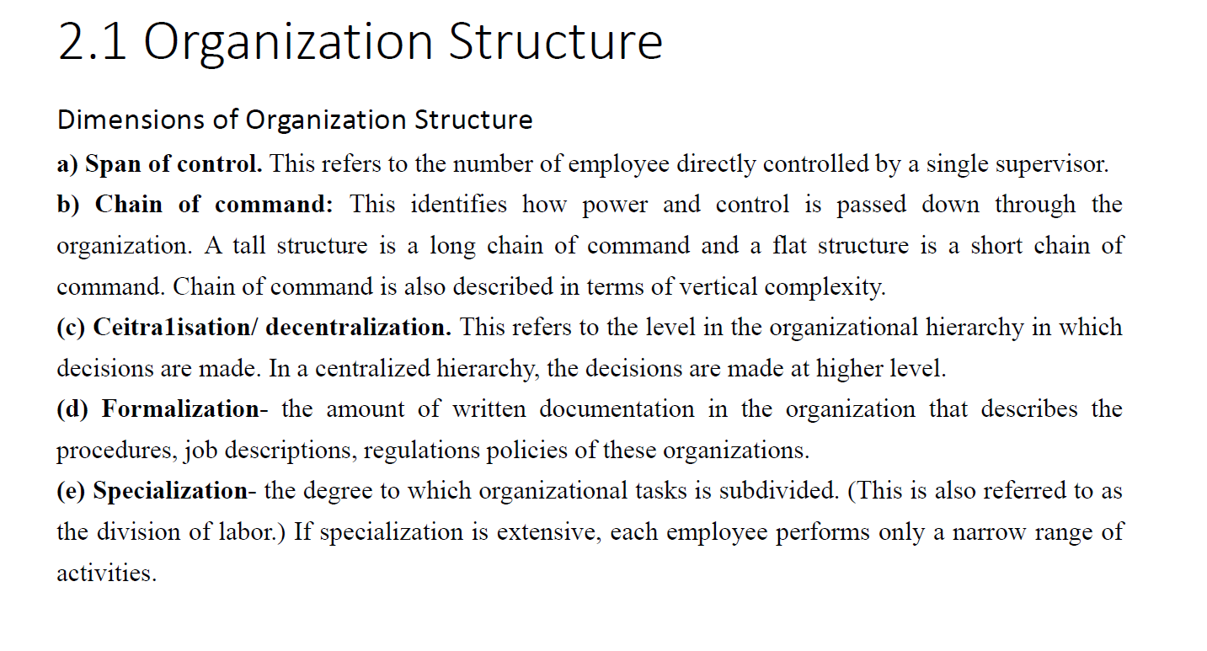

Slide 25
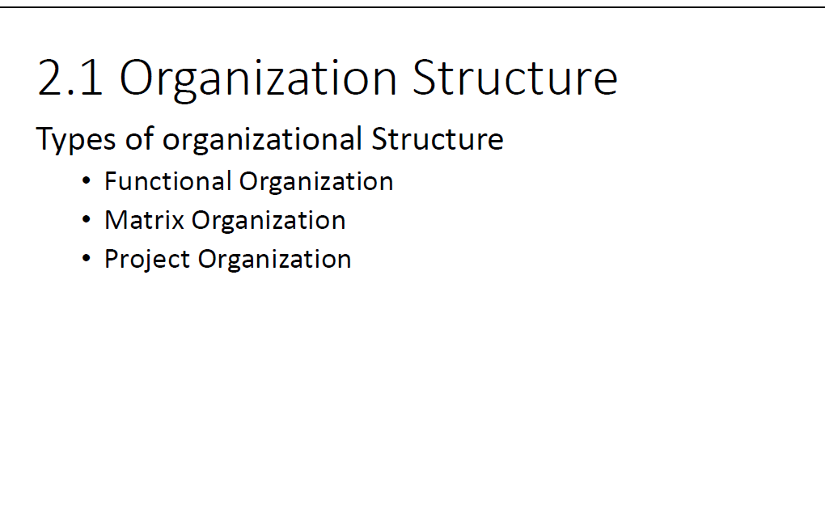

Slide 26
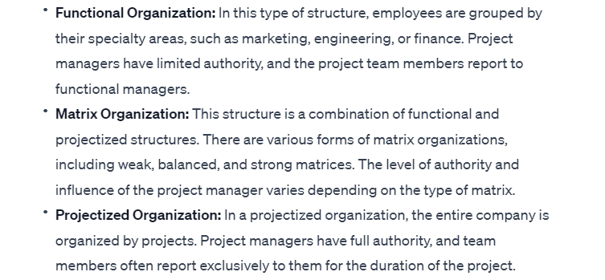

Slide 27
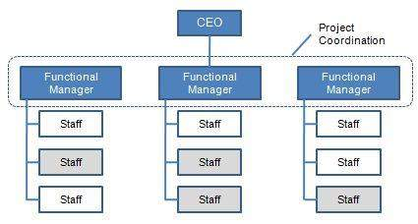

Slide 28
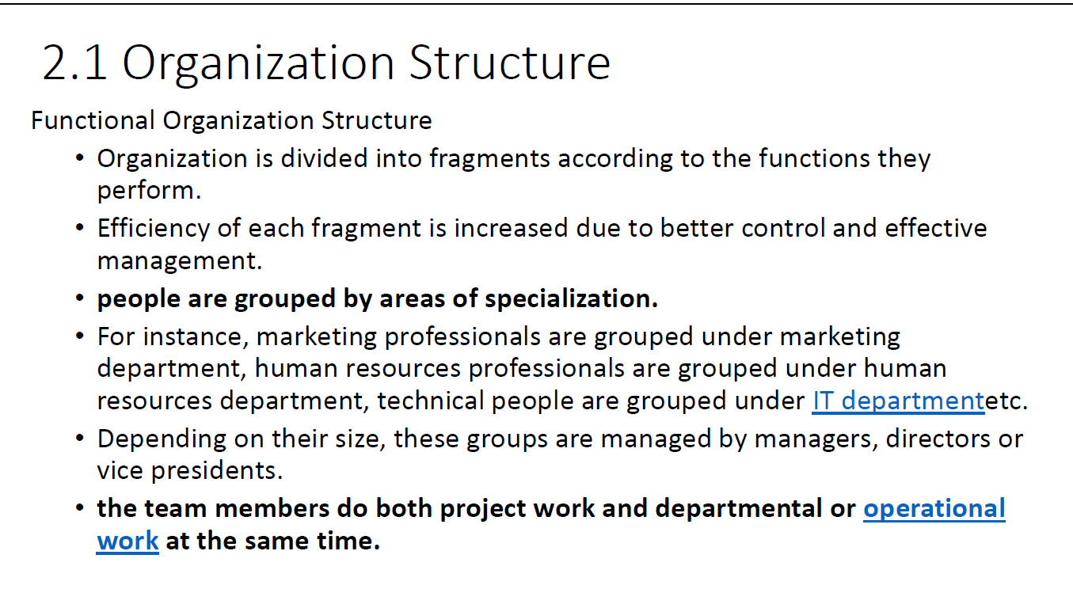

Slide 29
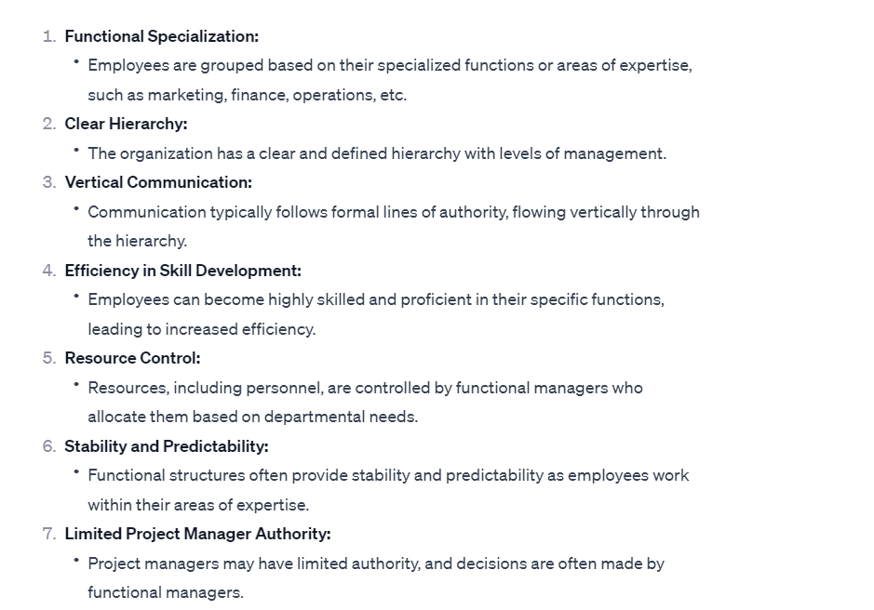

Slide 30
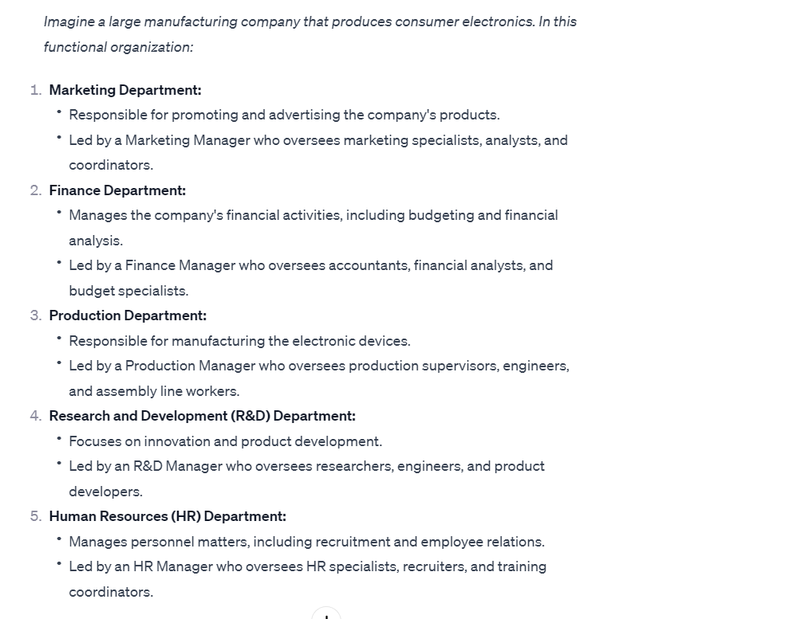

Slide 31
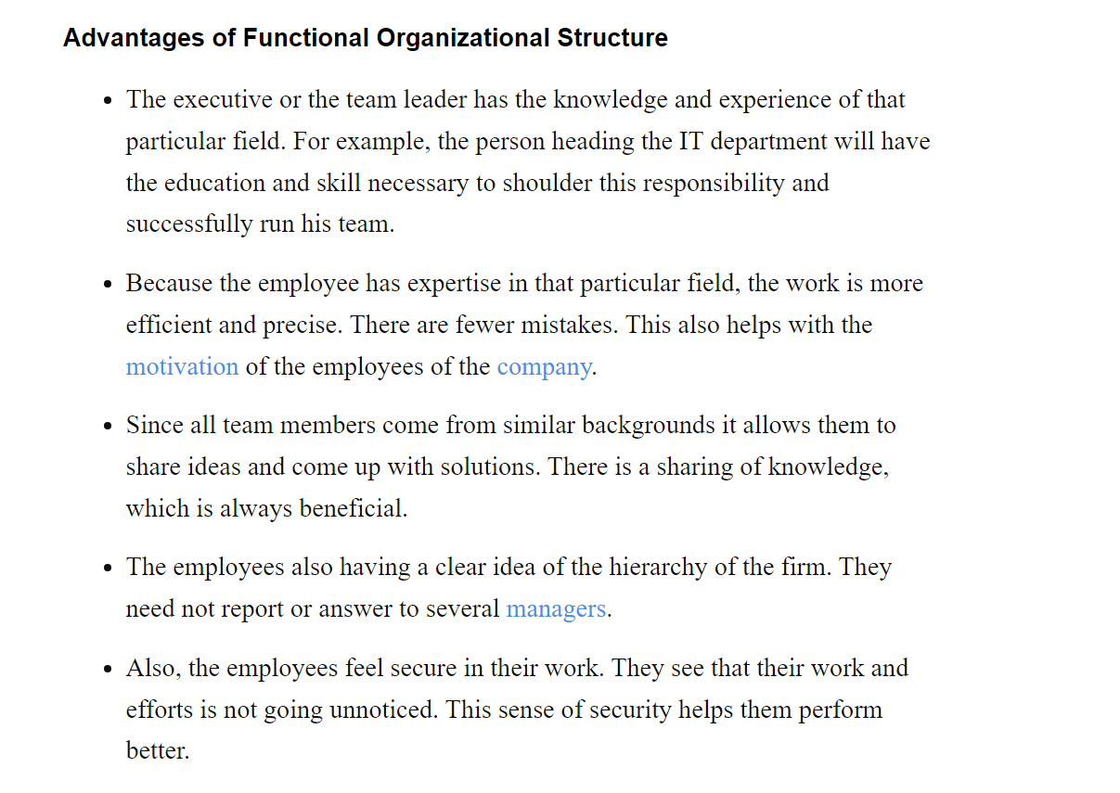

Slide 32
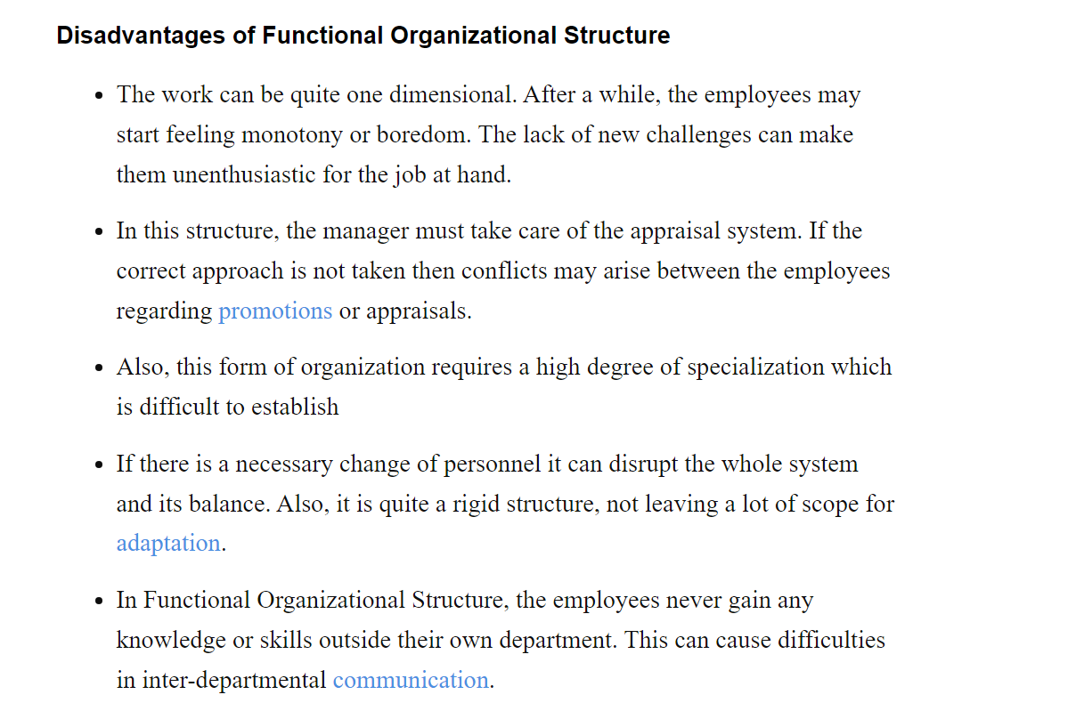

Slide 33
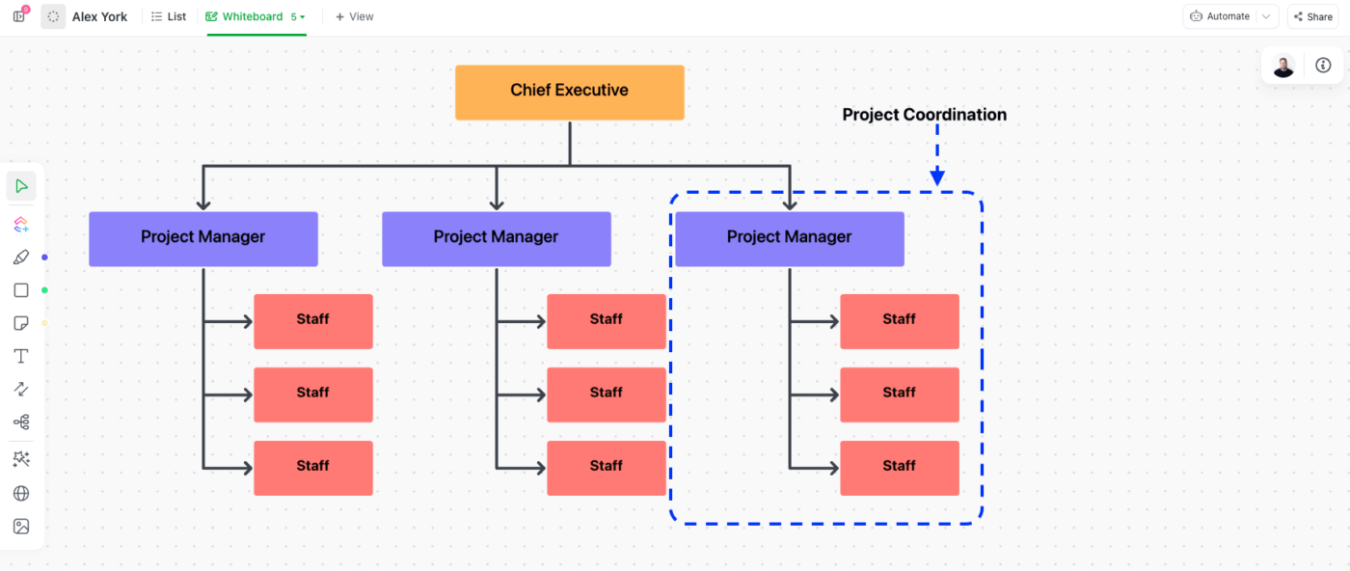

Slide 34
Projectized organizational Structure
A projectized organizational structure is a type of organizational design in which the company is structured around projects.
In this structure, the entire organization is organized by projects, and project managers have significant authority and control over resources.
This contrasts with functional structures, where employees are grouped by specialized functions (e.g., marketing, finance) and report to functional managers.

Slide 35
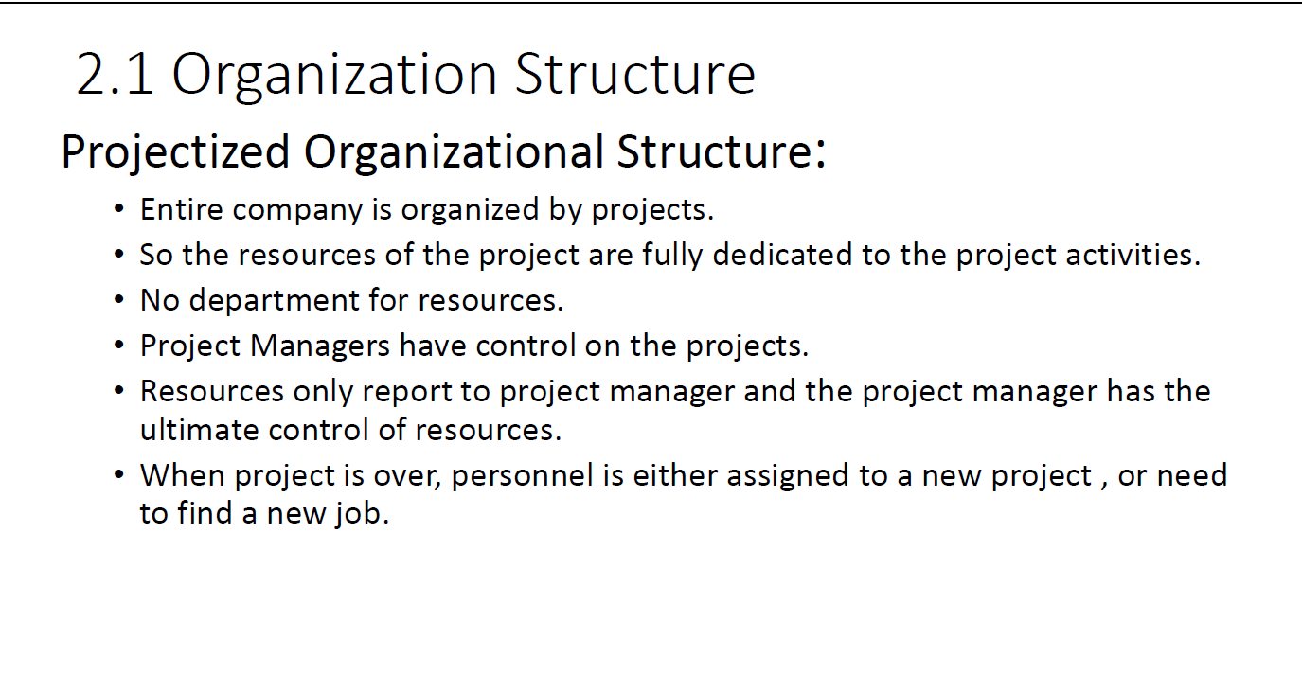

Slide 36
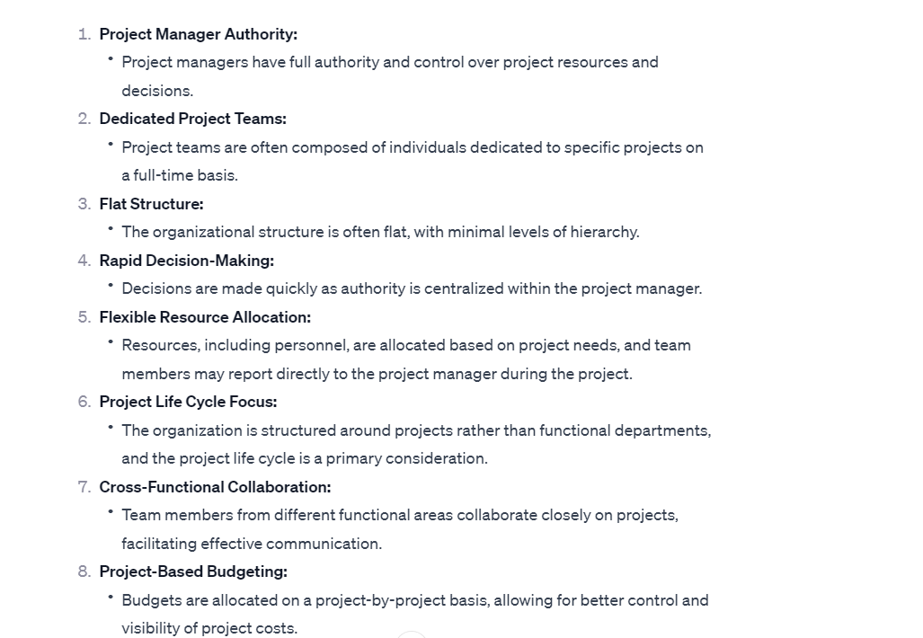

Slide 37
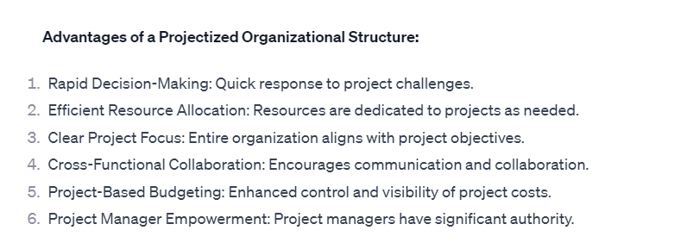

Slide 38
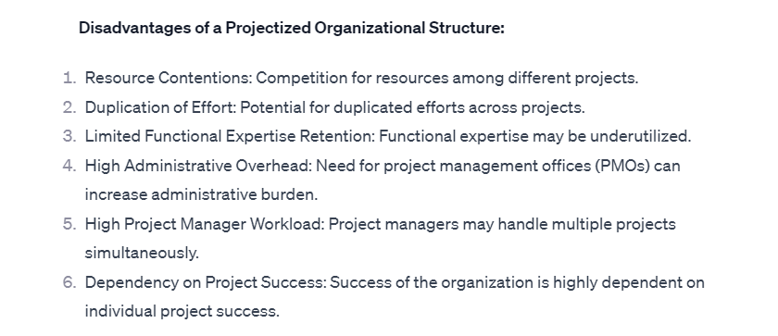

Slide 39
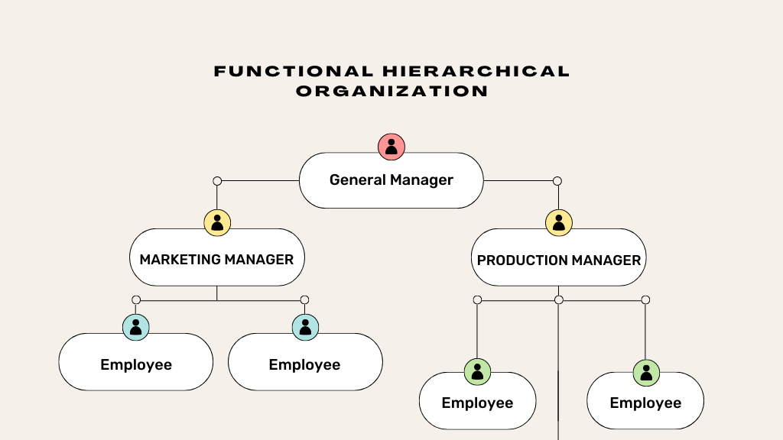

Slide 40
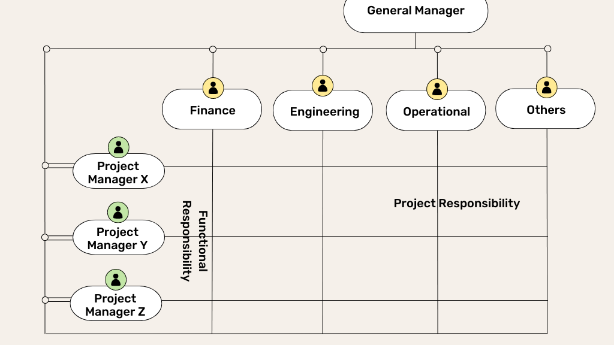

Slide 41
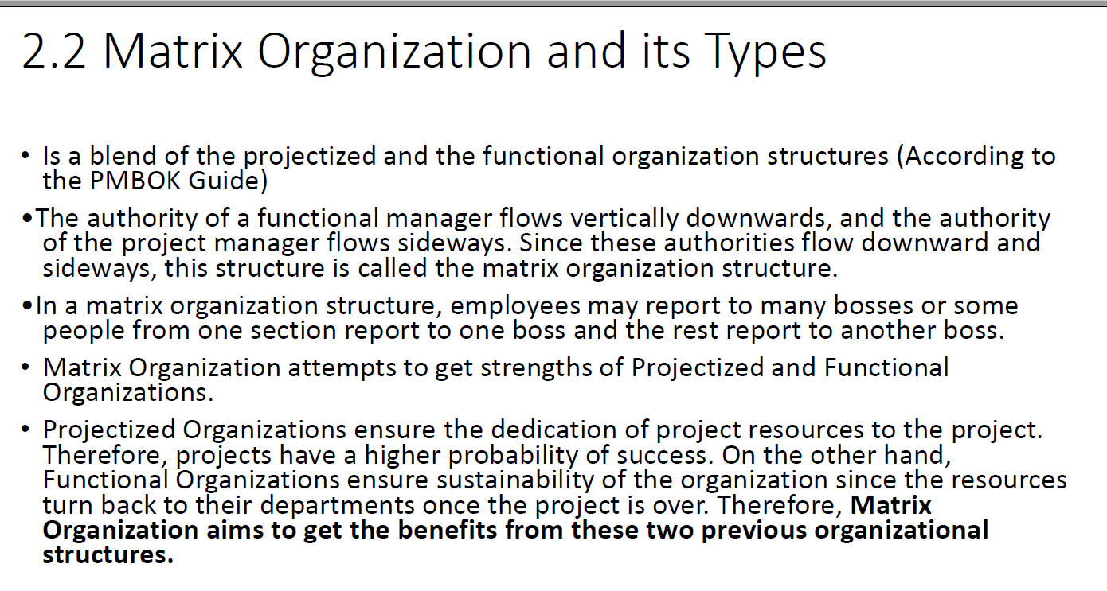

Slide 42
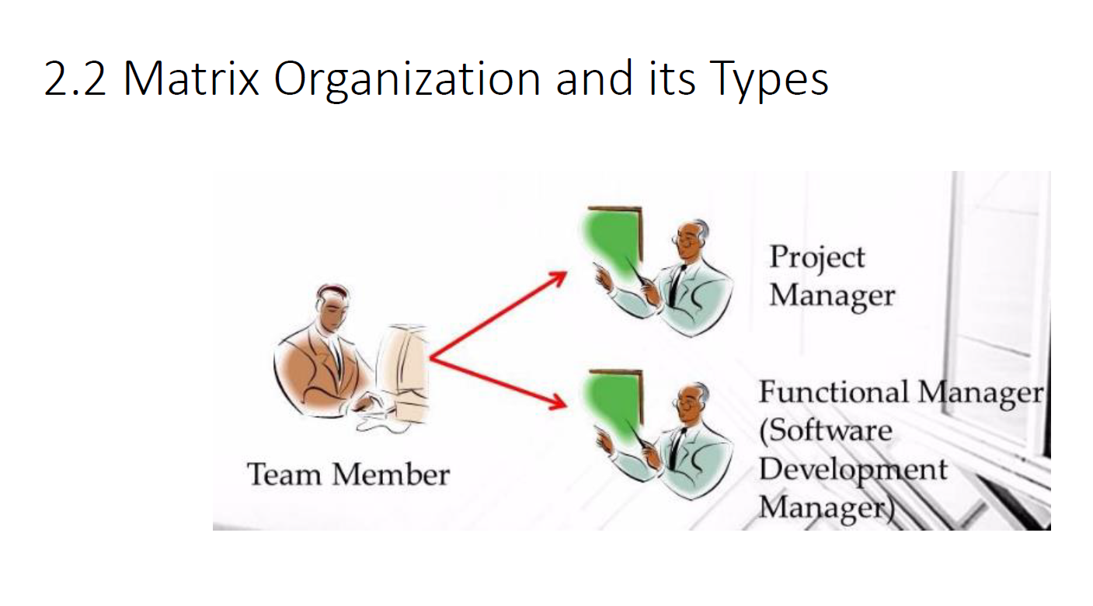

Slide 43
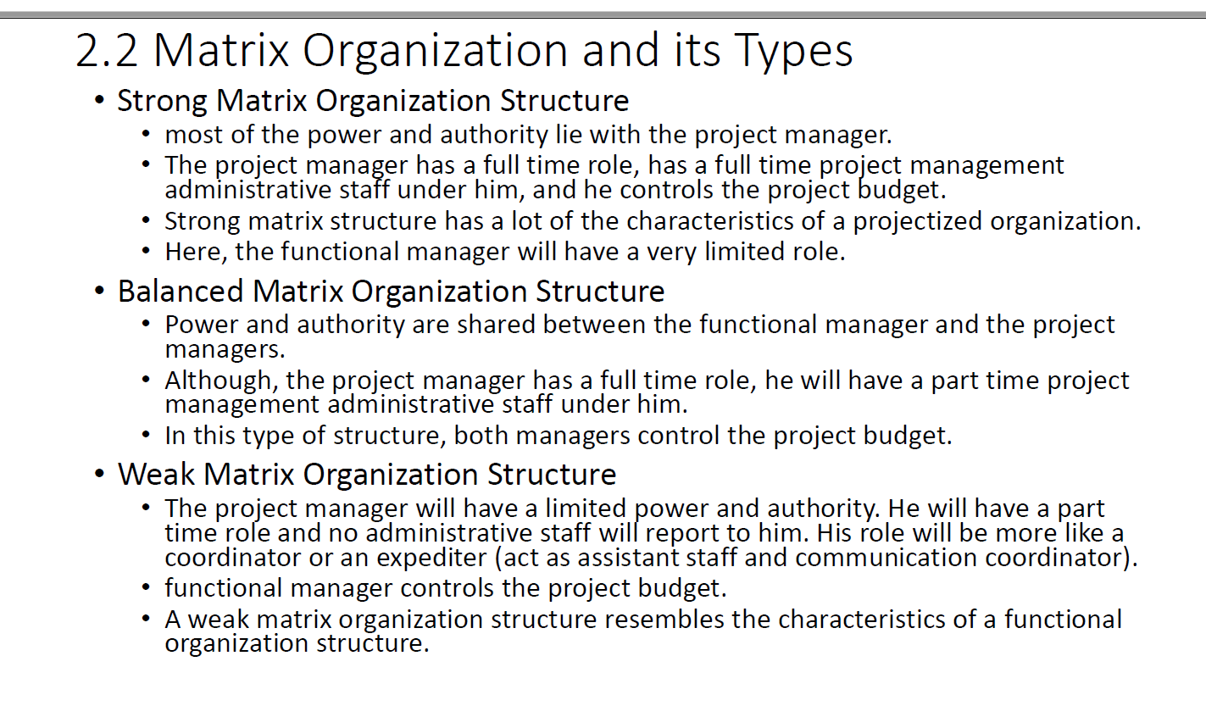

Slide 44
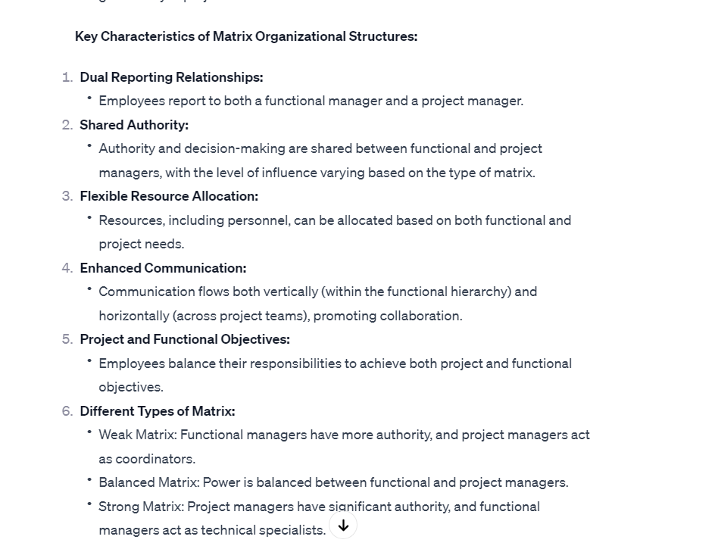

Slide 45
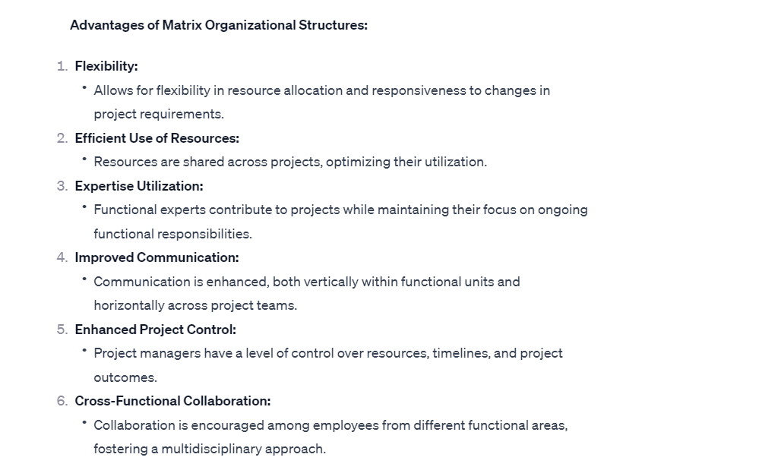

Slide 46
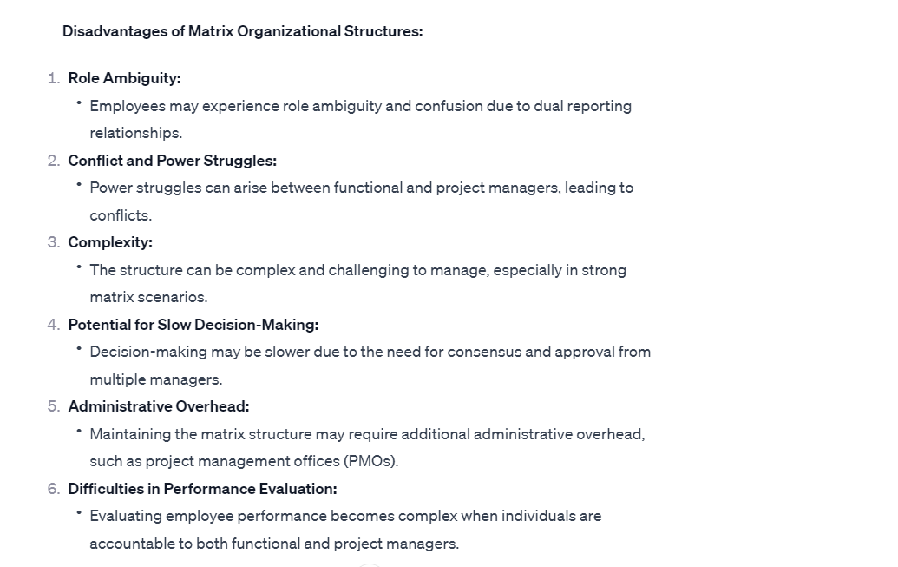

Slide 47
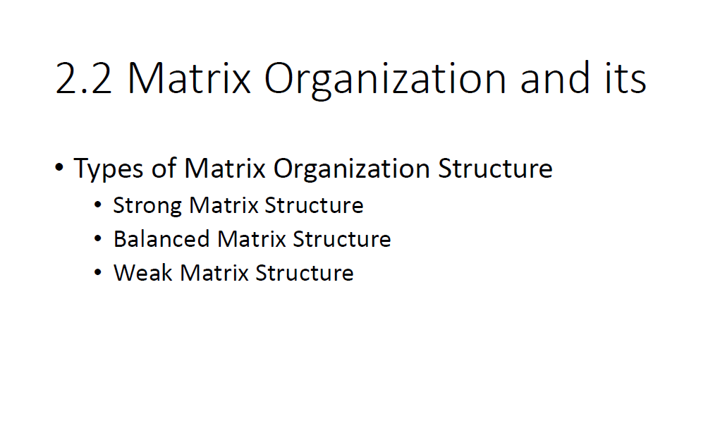

Slide 48
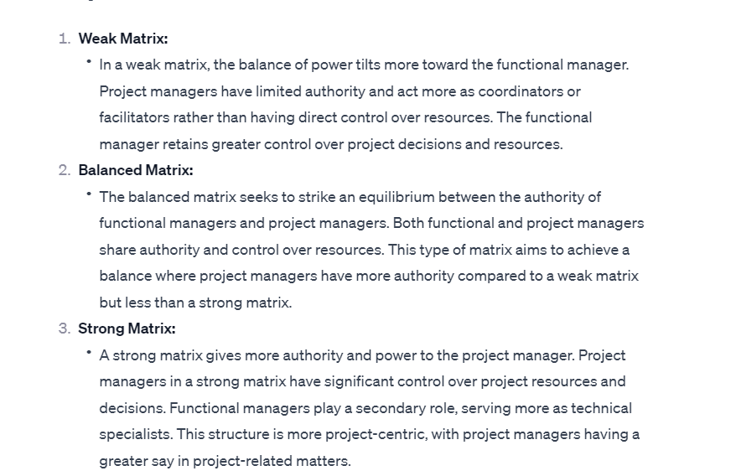

Slide 49
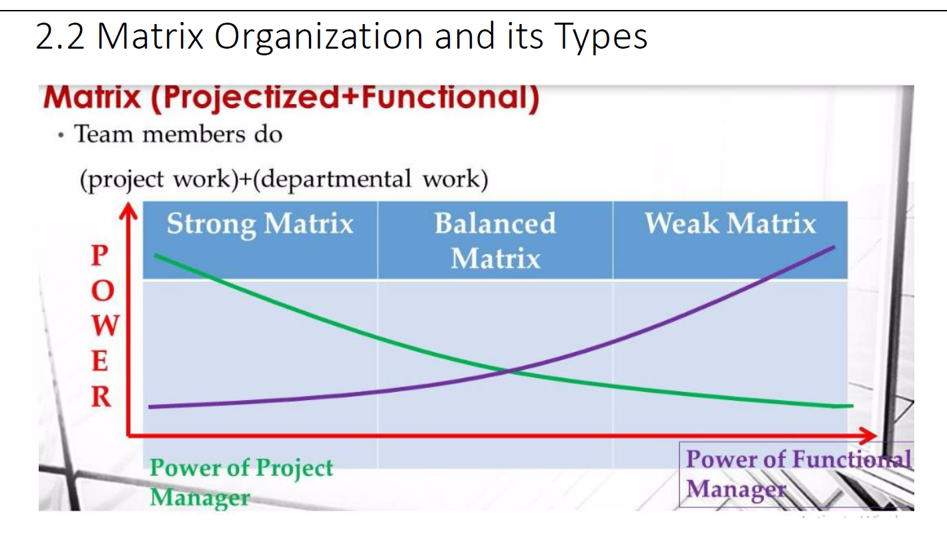

Slide 50
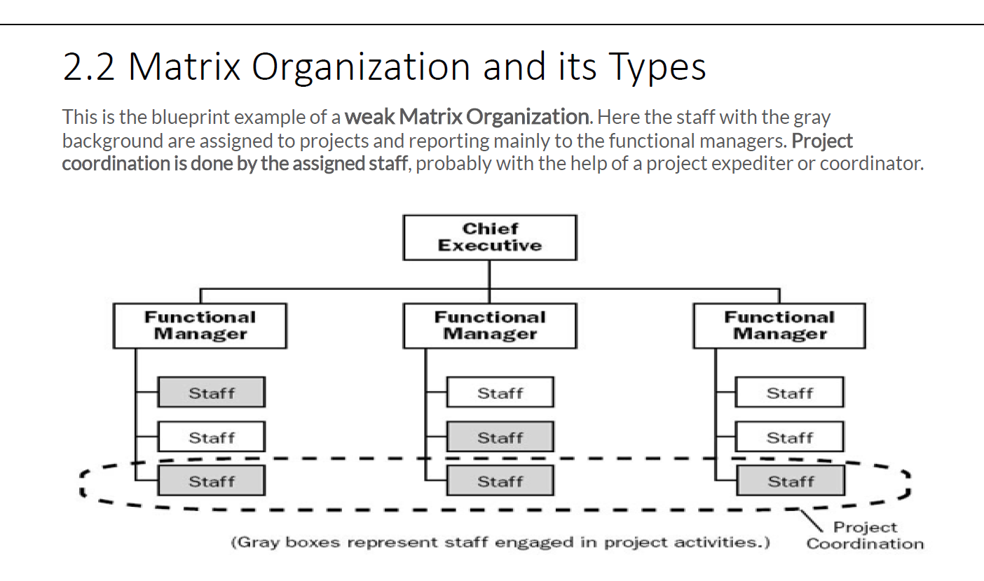

Slide 51
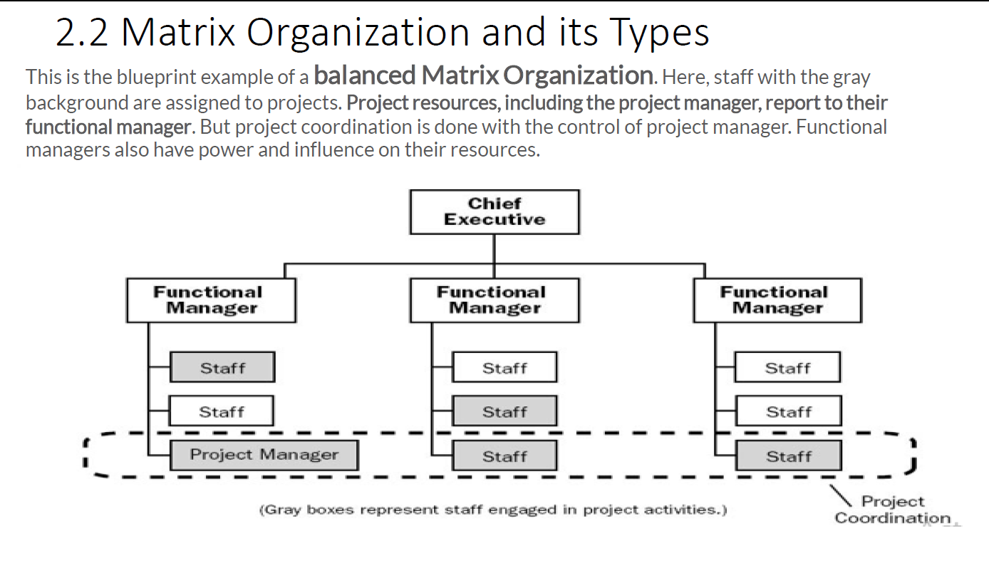

Slide 52


Slide 53


Slide 54


Slide 55


Slide 56


Slide 57


Slide 58


Slide 59


Slide 60


Slide 61


Slide 62
Project Manager:
Role: The leader responsible for overall project planning, execution, and completion.
Duties:
Develop and communicate the project plan.
Define project scope, objectives, and deliverables.
Allocate resources and manage the project budget.
Monitor and control project progress.
Identify and manage project risks.
Communicate with stakeholders.
Lead and motivate the project team.

Slide 63
Project Sponsor:
Role: Provides financial support and high-level guidance for the project.
Duties:
Secure project funding and resources.
Provide strategic direction.
Remove obstacles and roadblocks for the project team.
Approve major project decisions.
Advocate for the project at higher organizational levels.

Slide 64
Project Coordinator/Assistant:
Role: Supports the project manager in administrative tasks and coordination.
Duties:
Assist in project planning and documentation.
Schedule meetings and maintain project calendars.
Track and report project progress.
Help with communication between team members.

Slide 65
Subject Matter Experts (SMEs):
Role: Provide specialized knowledge and expertise in specific areas related to the project.
Duties:
Offer technical guidance and insights.
Collaborate with the project team to ensure accuracy and quality.
Contribute to decision-making in their areas of expertise.

Slide 66
Team Members:
Role: Execute tasks and activities required to meet project objectives.
Duties:
Complete assigned work packages and deliverables.
Collaborate with team members and share updates.
Participate in meetings and discussions.
Raise issues or concerns to the project manager.
Meet project deadlines.

Slide 67
Quality Assurance/Quality Control Specialist:
Role: Ensures that project deliverables meet established quality standards.
Duties:
Develop and implement quality control processes.
Conduct quality reviews and inspections.
Provide feedback to team members on quality issues.
Work to prevent defects and ensure compliance with requirements

Slide 68
Risk Manager:
Role: Identifies, assesses, and manages risks that could impact the project.
Duties:
Identify potential project risks.
Assess the likelihood and impact of risks.
Develop risk mitigation strategies.
Monitor and control identified risks.

Slide 69
Communications Manager:
Role: Manages internal and external project communications.
Duties:
Develop a communication plan.
Ensure consistent and effective communication.
Coordinate communication between team members.
Manage stakeholder expectations.

Slide 70
Procurement Manager:
Role: Manages the procurement process if external resources are needed.
Duties:
Identify external vendors or contractors.
Develop procurement documents.
Evaluate proposals and select vendors.
Manage contracts and vendor relationships.

Slide 71
Customer/User Representative:
Role: Represents the interests and needs of the end-users or customers.
Duties:
Provide input on project requirements.
Participate in user acceptance testing.
Offer feedback on deliverables from the end-user perspective.

Slide 72
Suppliers and Vendors:
Role:
Organizations or individuals providing goods or services to the project.
Responsibilities:
Deliver products or services according to agreed-upon terms.
Collaborate with the project team to meet project requirements.
Provide input on technical or logistical aspects of the project.

Slide 73
Regulatory Authorities:
Role:
Government or industry bodies that regulate certain aspects of the project.
Responsibilities:
Approve and monitor compliance with regulations.
Provide permits or approvals required for the project.
May conduct audits or inspections.

Slide 74


Slide 75


Slide 76


Slide 77


Slide 78


Slide 79


Slide 80


Slide 81


Slide 82


Slide 83


Slide 84


Slide 85


Slide 86


Slide 87


Slide 88


Slide 89


Slide 90


Slide 91


Slide 92


Slide 93


Slide 94


Slide 95


